Slide 1
Systems and Control – KNI Progress

Slide 2
Overview
Project Documents and References:
Updated Project Plan link:
https://docs.google.com/spreadsheets/d/13fnGmyryrXdKehZI0Lgd8S8gyoj8Td7e2qmtAMIzkO4/edit#gid=0
URL for user training and tests
https://dev-two-erp-india.kokonetworks.com/web/login
High Level Progress Summary
Testing with multi company dependencies completed
Training to users initiated and completed 2 sessions
Infrastructure and licences cost estimated included in the upcoming slides.

Slide 3
Progress Report Details
Completed Activities
QA tests for Asset Management and GST compliance reporting is completed
Multi company level functional and technical issues resolved and verified.
Walkthrough to Vivek and team (Bhavsar, Keval and Dharmesh) for Procurement and Accounts.
Training to team for V14 related modifications on top of V11 work flows.
Two training sessions completed.
In Progress:
Configuration templates for Master data on production instance
Training and handhold support to above team for process verification on UAT.
Next Activities Plan
Preparations of infra for production instance
Setting up KNI production instance with Odoo Enterprise 14
Procurement of Odoo 14 licenses, initiate with Odoo team.
UAT Handhold and Masters Templates:
Work with users to handhold them on functional queries and support for next week.
Configuration of Master data or import using templates to start with will be planned.
Documentation:
User guides for team as per modules configured and functional flow.

Slide 4
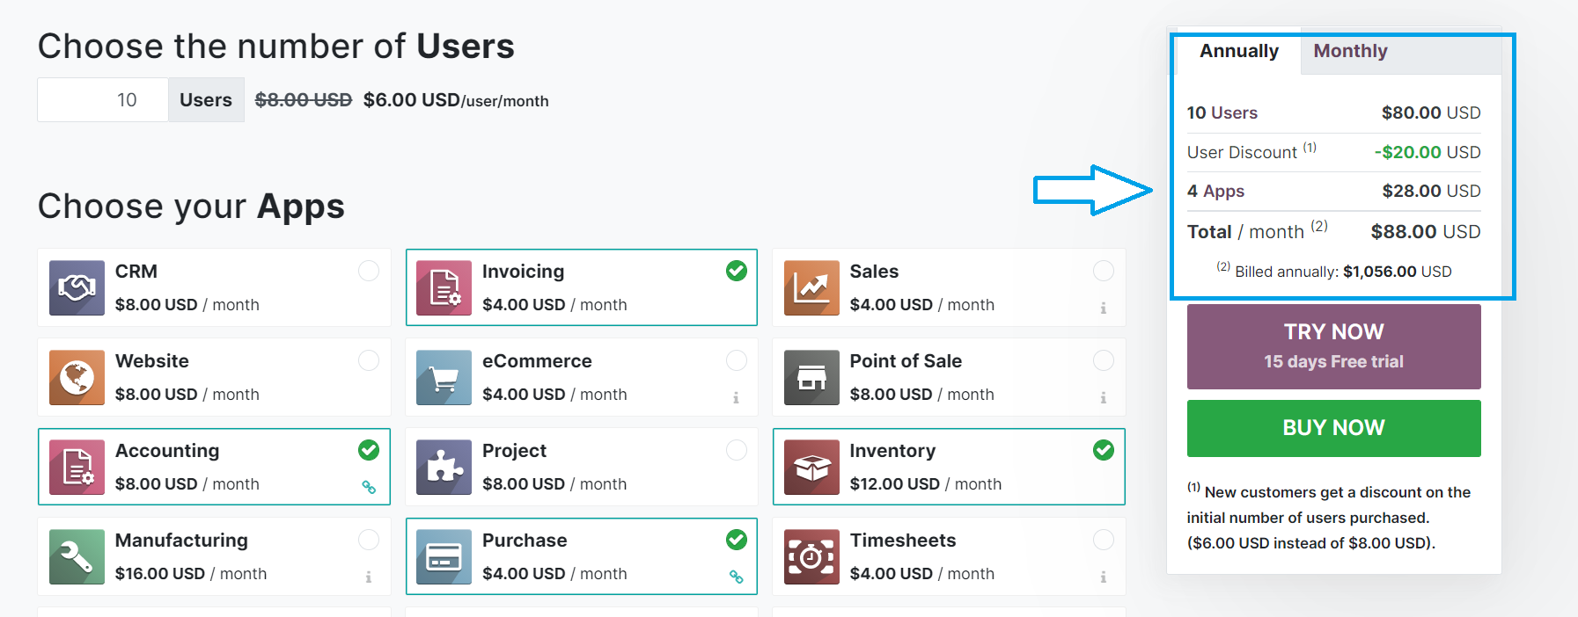
Odoo Licenses Estimated Cost
As per Odoo website, details of 10 users with required modules for KNI instance per year would be as shown below.

Slide 5
Risks and Action Items
Risks
Engineering Resource availability for deployment and other support tasks
External Action Items
Server configuration and instance suggestions – Arvind and Sid
(Coordinate with VERTS for suggested infrastructure considering SAARUS environment to be deployed once migration is complete on the same or different instance?)

Slide 6
Siddique Momin
s.momin@kokonetworks.com

